Slide 1

Jaypee University of Engineering and Technology
MAJOR
PROJECT-2 PRESENTATION
PRESENTED BY
Bebandh Shrivastava
Jeet Gupta
Vaishali Srivastava
Urshita Motwani
PicFlick :Enhanced AR Filters Application
Project Number : AR1
MENTORED BY
Dr. Amit Kumar Rathi

Slide 2



PicFlick : AR Fliters App
Bebandh Shrivastava
(211B090)
1
Scriptwriting and AI
Our Team
Vaishali Srivastava
(211B337)
2
User Interface
and Roles
Urshita Motwani
(211B334)
3
Design and Research
Jeet Gupta
(211B154)
4
Workflow and Assets

Slide 3
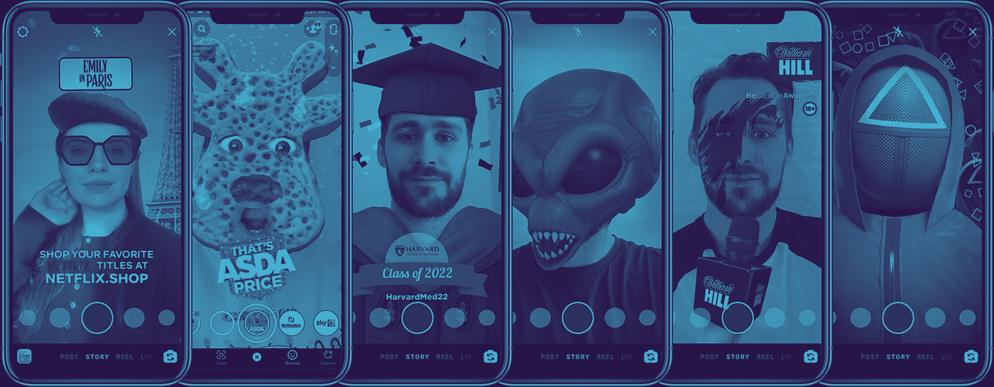
PicFlick : AR Filters App
OVERVIEW
PicFlick is a dynamic AR filters application being developed using Python and langchain that allows users to enhance their photos with a wide range of creative and interactive filters. These filters, categorized by themes and can be applied in real-time while capturing content through augmented reality. This app also features an AI chatbot which can conversate with you and perform sentiment analysis in real time to suggest you the best filter according to your mood .

Slide 4







PicFlick : AR Fliters App
Tools and Technologies
Streamlit
Blender
Lens Studio
Ambient CG
Python
Gemini
Langchain
Langsmith

Slide 5
PicFlick : AR Fliters App
SIMPLIFYING AR CONTENT CREATION
Helping users effortlessly engage in AR content for personal, professional, or social media use.
Objectives
MOOD ANALYSIS
Goals we aim to achieve with this project.
Users can engage in a conversation with our personalized chatbot which can analyse the user’s sentiment and based on it suggest the perfect filter from our library .
SEGMENTATION
Segmenting the filters, categorized by themes such as nature, retro, futuristic, funny and special events (holidays, festivals) making it easy for the user to choose the correct overlay according to the mood and environment .

Slide 6

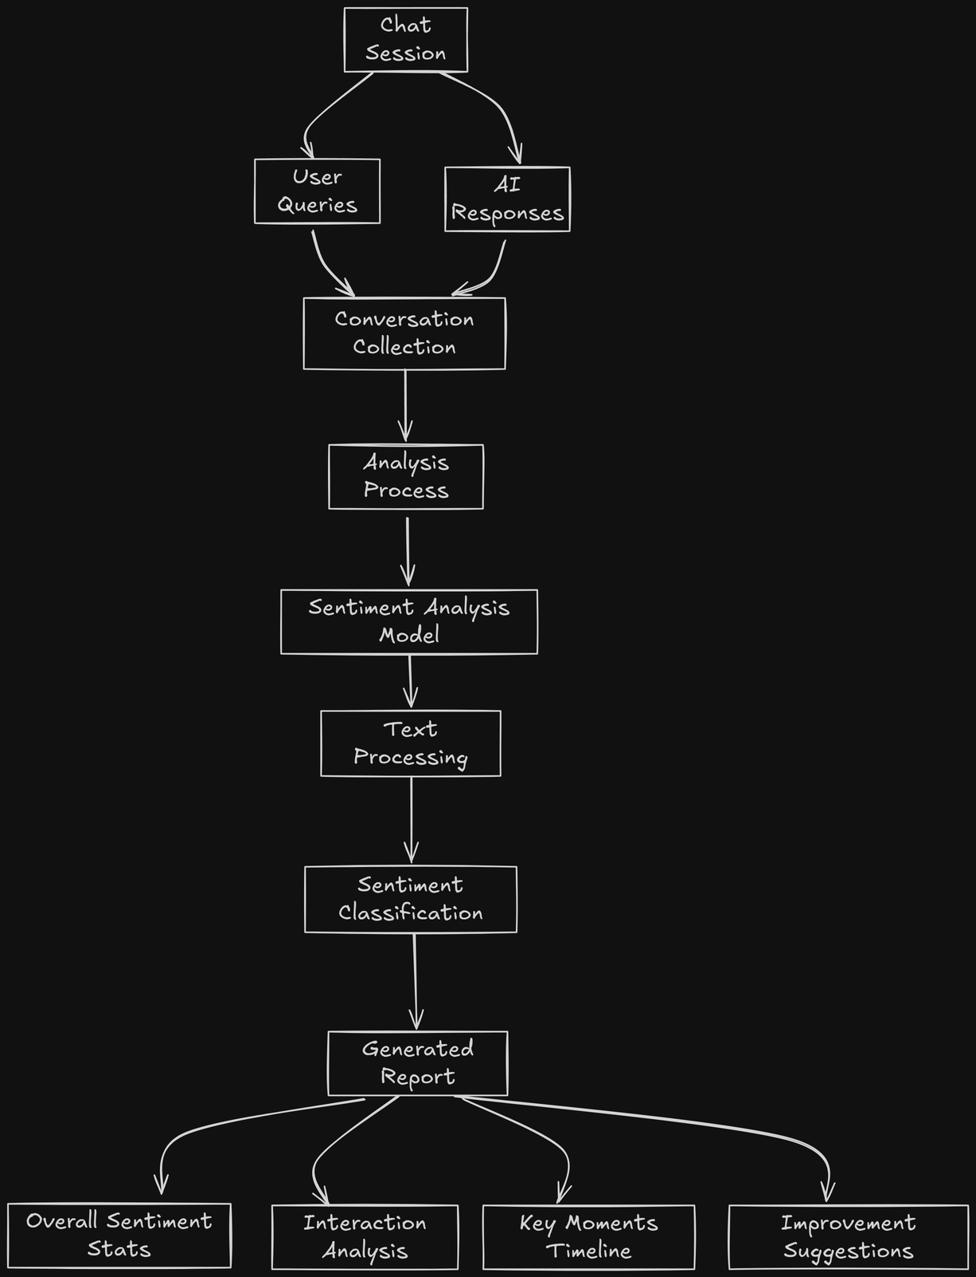
PicFlick : AR Filters App
Sentiment Analysis
Objectives:
Detect user emotions to adapt responses.
Feedback Gathering from the report
Features:
Overall Sentiment Statistics
Interaction Analysis
Improvement Suggestions.

Slide 7
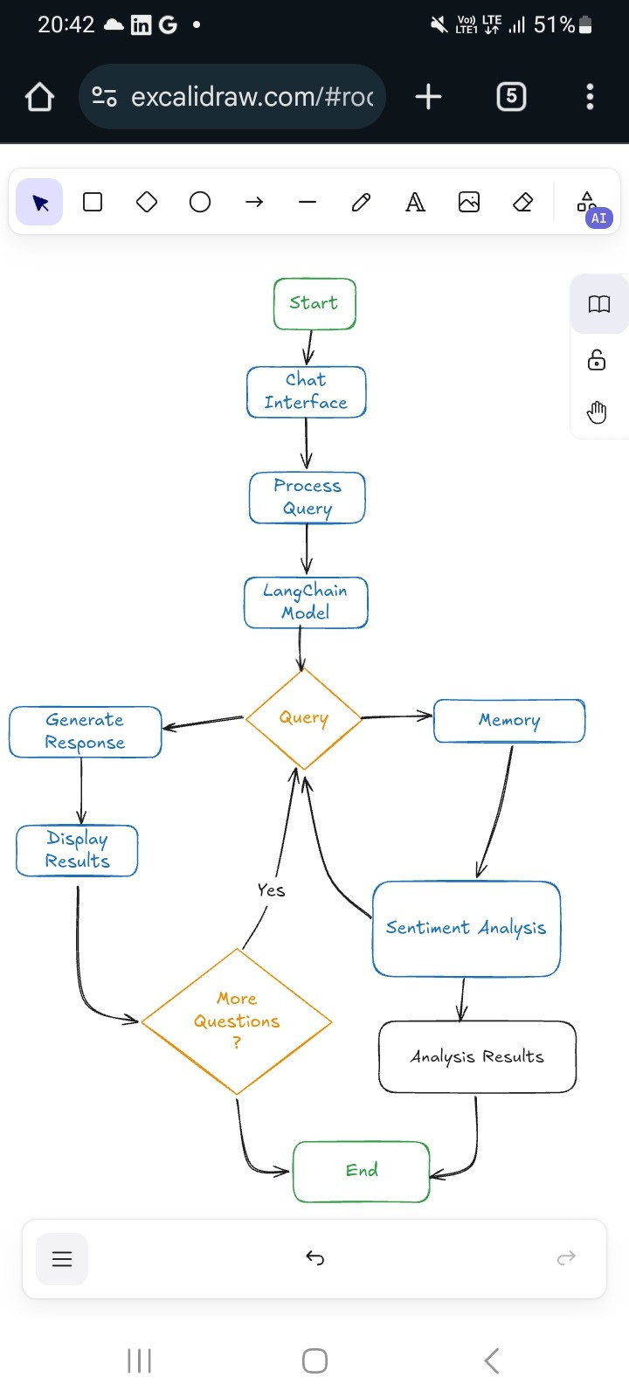
PicFlick : AR Filters App
Working of the chatbot
Chat Interface: The user gives their query through the interface.
Process Query: The system takes the user's input and processes it for analysis.
LangChain Model: We use the Gemini API to build the model.
Query Decision: If information is required from Memory, the system retrieves it. Next, it moves to Sentiment Analysis to check the mood or tone of the question.
Generate Response: The system formulates an appropriate reply for the user.
Display Results: The response is displayed to the user.

Slide 8
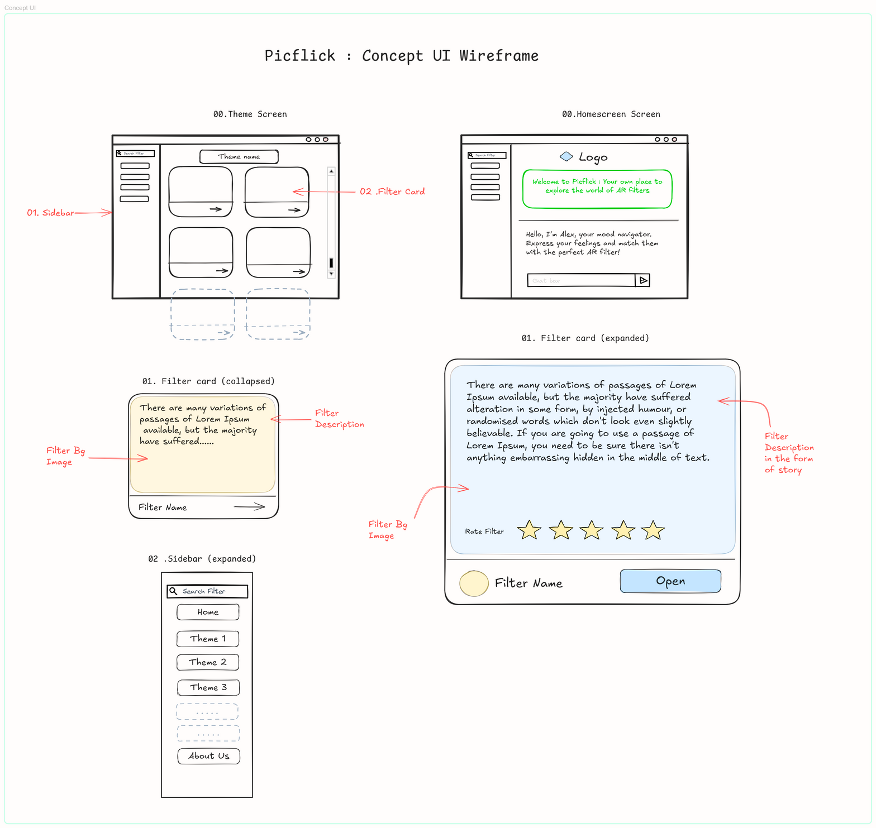
PicFlick : AR Filters App
CONCEPT UI : WIREFRAME
PICFLICK

Slide 9
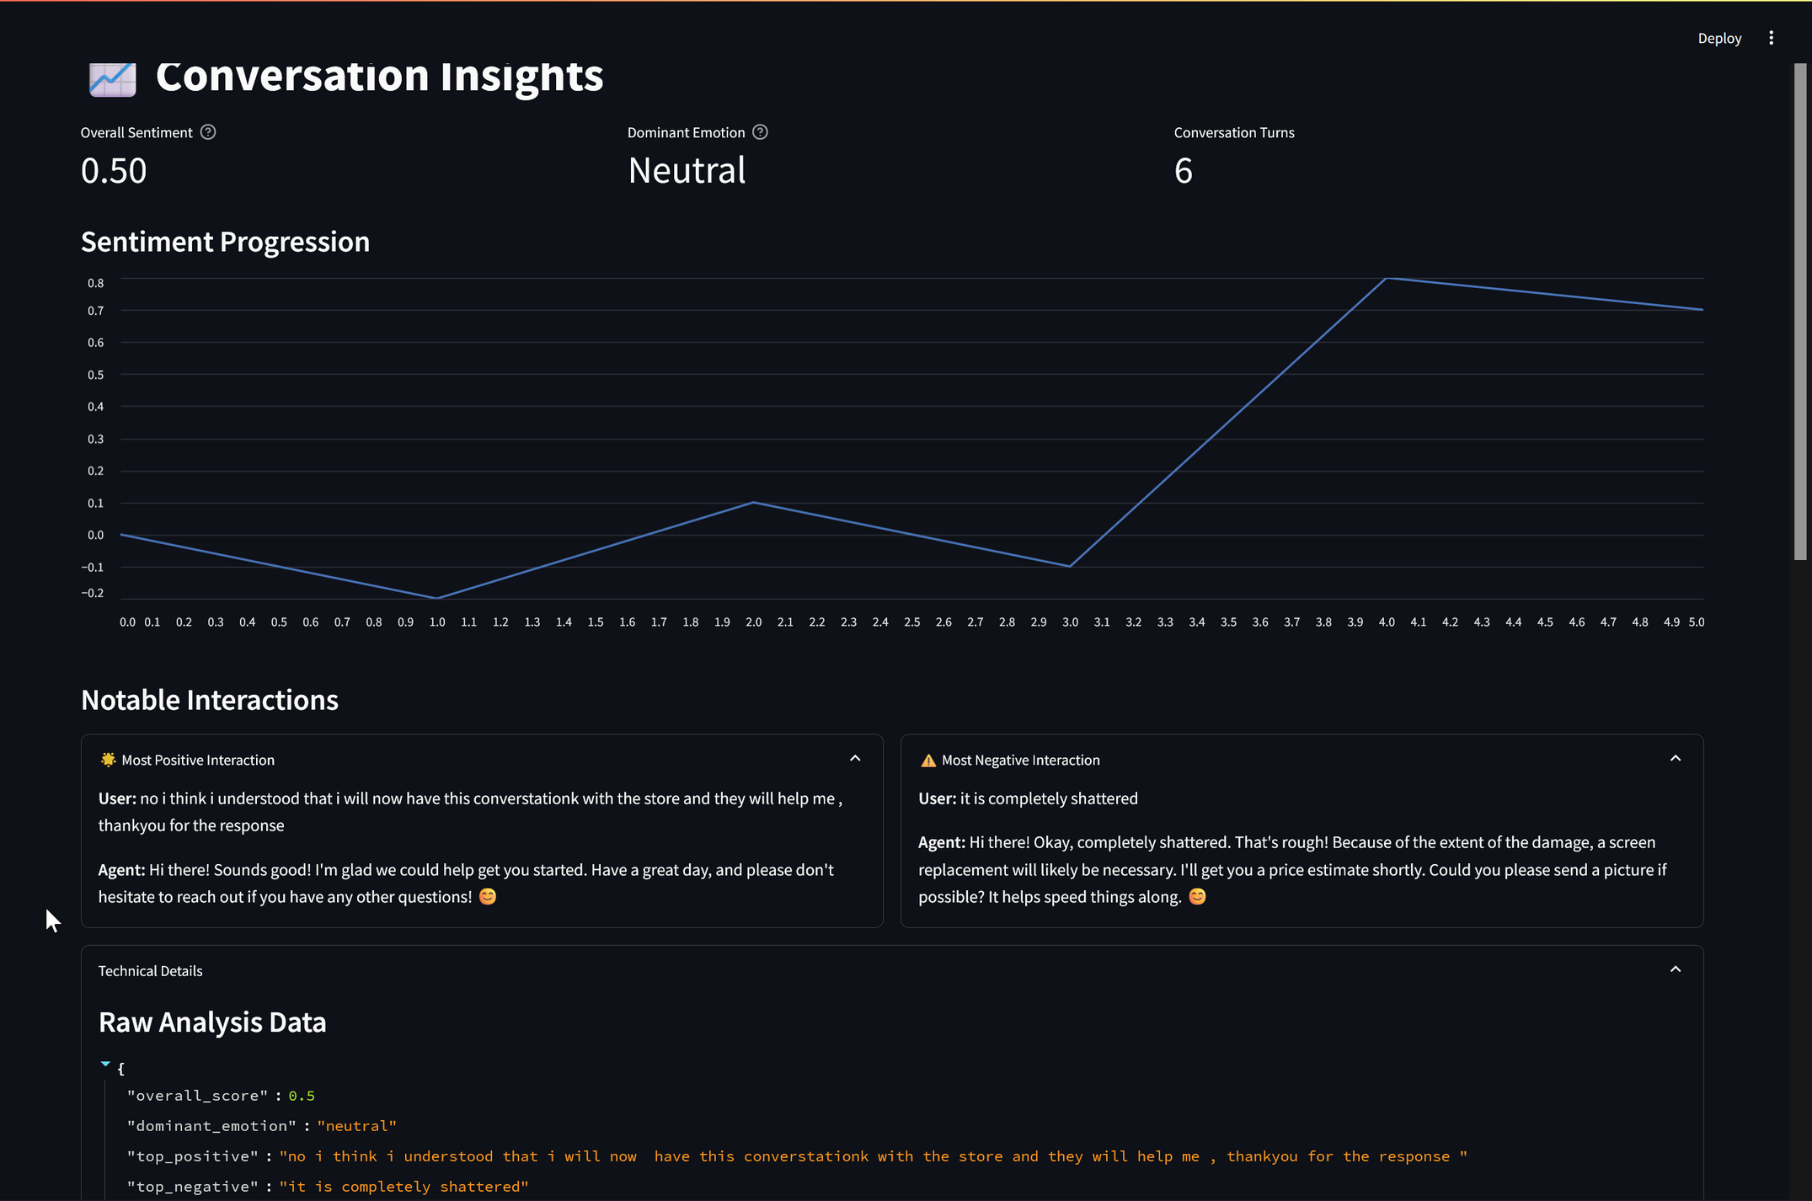
PicFlick : AR Filters App
A GLANCE
AT
SENTIMENT
ANALYSIS
INTERFACE

Slide 10
PicFlick : AR Filter Book
ASSET CREATION
Created low poly assets with textures and exported them to Lens studio for testing .
Work we've done so far
CREATING A UI PROTOTYPE
We created an initial wireframe of the user interface in and created a prototype of the frontend in streamlit.
Summary
BASIC CHATBOT FOR TESTING MOOD ANALYSIS
We have implemented a working chatbot using langchain and gemini API .

Slide 11
PicFlick : AR Filter Book
Week(1-5)
Week(5-7)
Weeks(8-11)
Learning Langchain fundamentals
Creating basic AR assets in Blender ,
Creating initial wireframe of user interface in Excalidraw and creating a prototype UI in streamlit
Understanding Debugging with langsmith
Scripting and adding functionality in the filters
creating a chatbot and integrating in the UI
Fine tuning the AI chatbot for the appropriate chat style
Fixing Bugs
Deployment on the cloud and management of resources
Proposed Timeline

Slide 12
PicFlick : AR Filter Book
1 | https://python.langchain.com/docs/introduction/
2 | www.AmbientCg.com
3 | https://docs.streamlit.io/
4 | https://www.youtube.com/@SnapAR
5 | Excalidraw: https://excalidraw.com/#json=ja7syQPcdcTEo2m6QJMLw,-rFGpA2DKMxH3HrHrRCvVQ
Resource Page

Slide 13
PicFlick : AR Filter Book
Thank you for your patience.

